Slide 1
LLM Batch Processing Using Spark Distributed Systems
Tweet Sentiment Analysis

Slide 2
Prerequisites
Spark
Multiple Computers (Single Computer too can work but Multi-node cannot be displayed)
Transformers Library
Google/flan-t5-small model (Will be downloaded automatically when you run the program once)

Slide 3
Contents
Tweets of political parties (CSV)
Tweets extraction Guide
Walkthrough Guide
Code for Sentimental Analysis (my_spark_app.py)
Note: You can also create your own Dataframe with own content (See Code)

Slide 4
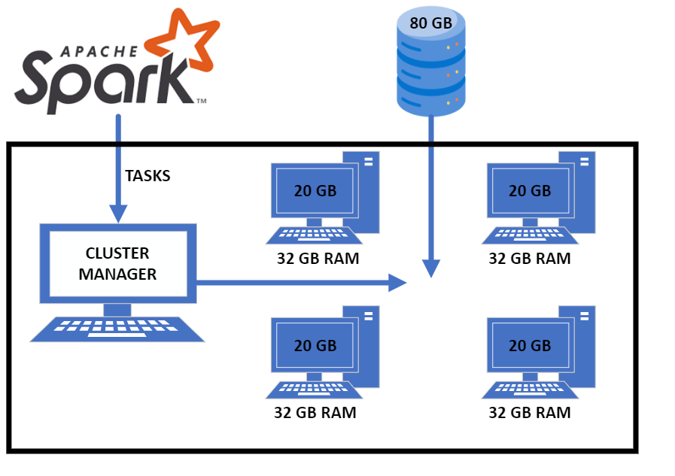
WorkFlow

Slide 5
Setting Up the Master Node

Slide 6
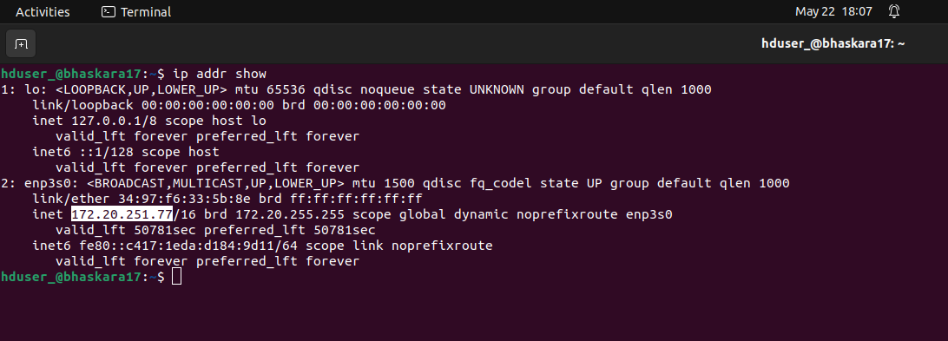
ip addr show – To Check the Master Node IP Address
cd $SPARK_HOME/conf
cp spark-env.sh.template spark-env.sh
export SPARK_MASTER_HOST=<give your own ip address>
export SPARK_MASTER_PORT=7077
export SPARK_WORKER_CORES=3
export SPARK_WORKER_MEMORY=3g
$SPARK_HOME/sbin/start-master.sh

Slide 7
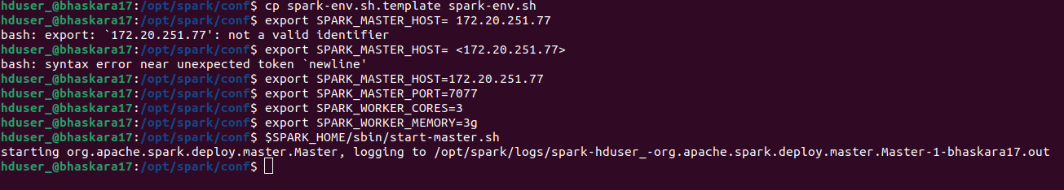
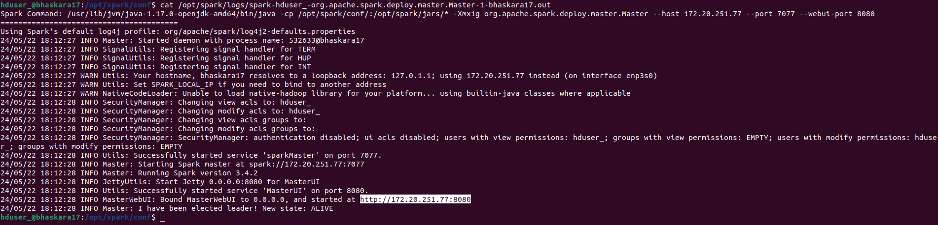
cat /opt/spark/logs/spark-hduser_-org.apache.spark.deploy.master.Master-1-bhaskara17.out

Slide 8
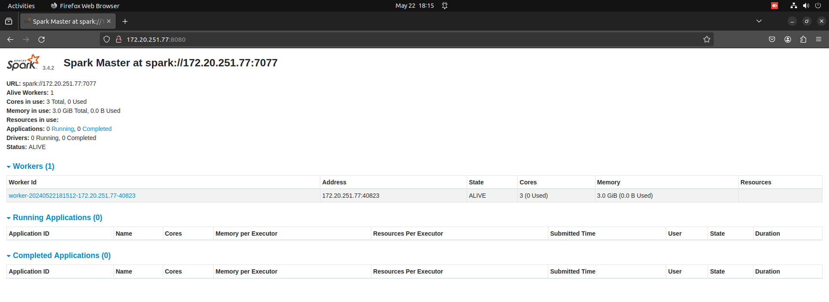
On accessing the highlighted section, it takes you to Spark UI which lets you see worker nodes status and Job application status.

Slide 9
Setting Up Worker Nodes

Slide 10
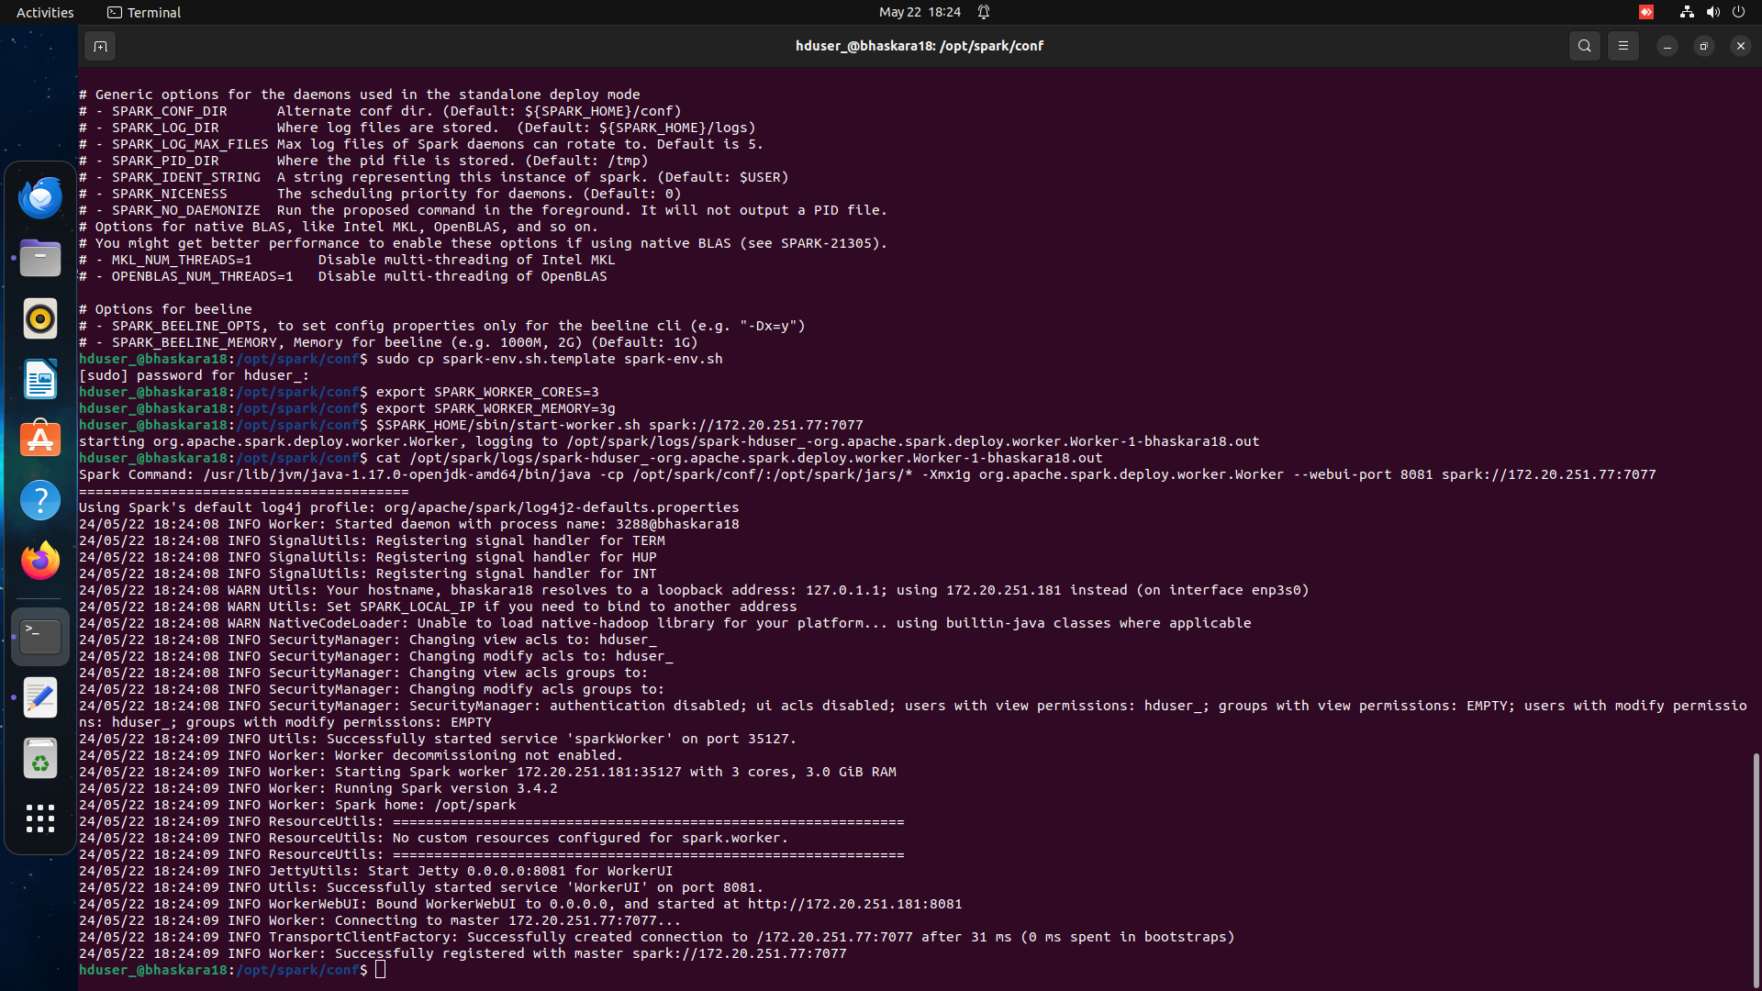
Note: Master Node can also act as Worker Node !
cd $SPARK_HOME/conf
cp spark-env.sh.template spark-env.sh
export SPARK_WORKER_CORES=3
export SPARK_WORKER_MEMORY=3g
$SPARK_HOME/sbin/start-worker.sh spark://<master node ip>:7077

Slide 11
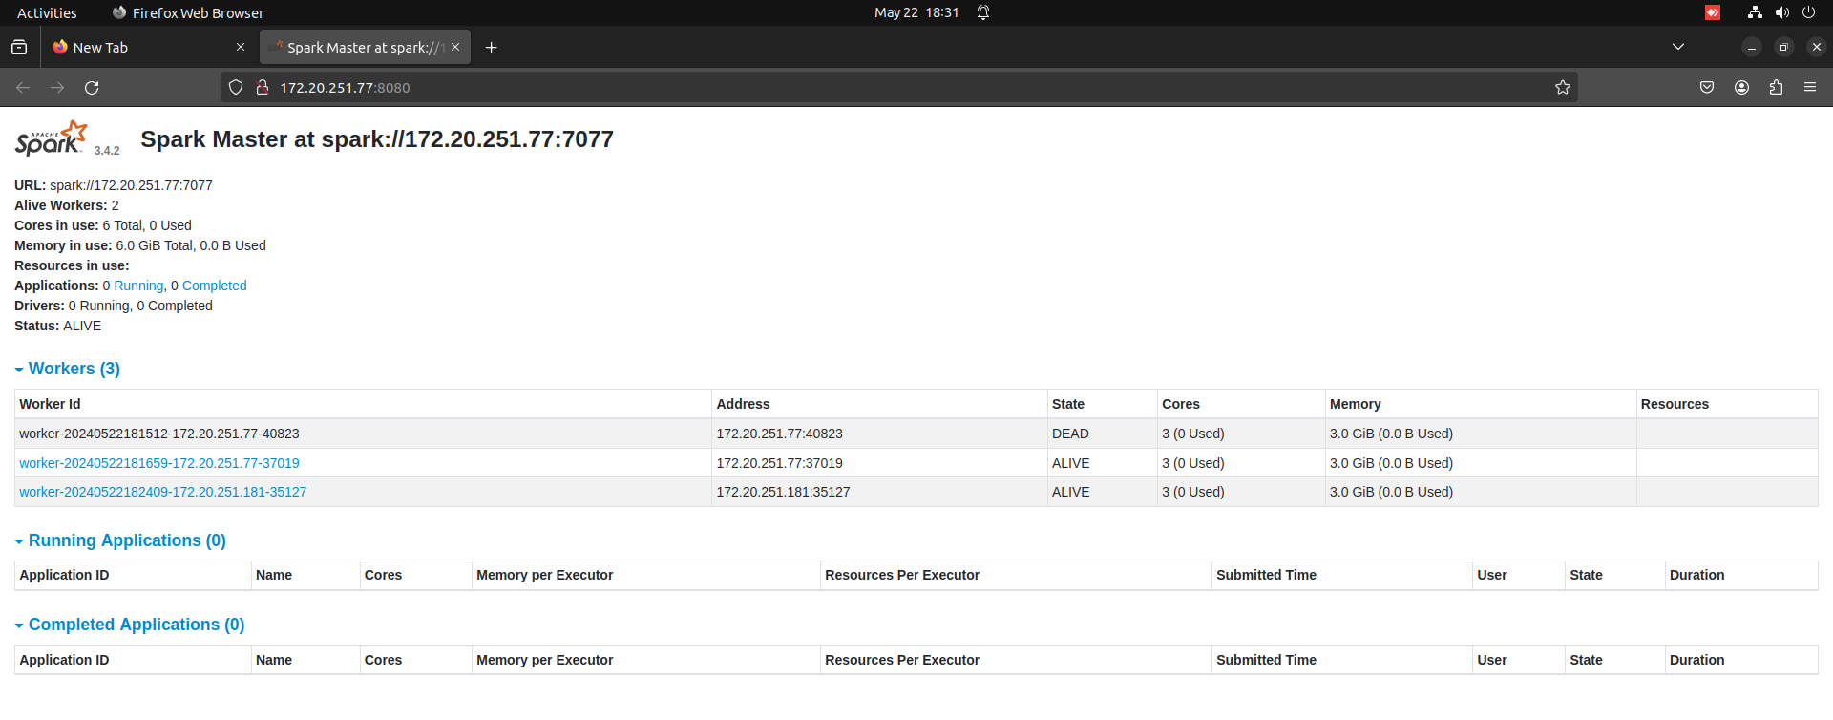
Refresh Spark UI

Slide 12
Tweet Sentiment Analysis

Slide 13
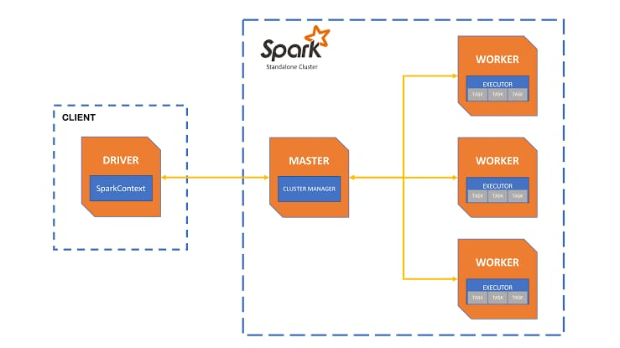
Workflow (Again)

Slide 14
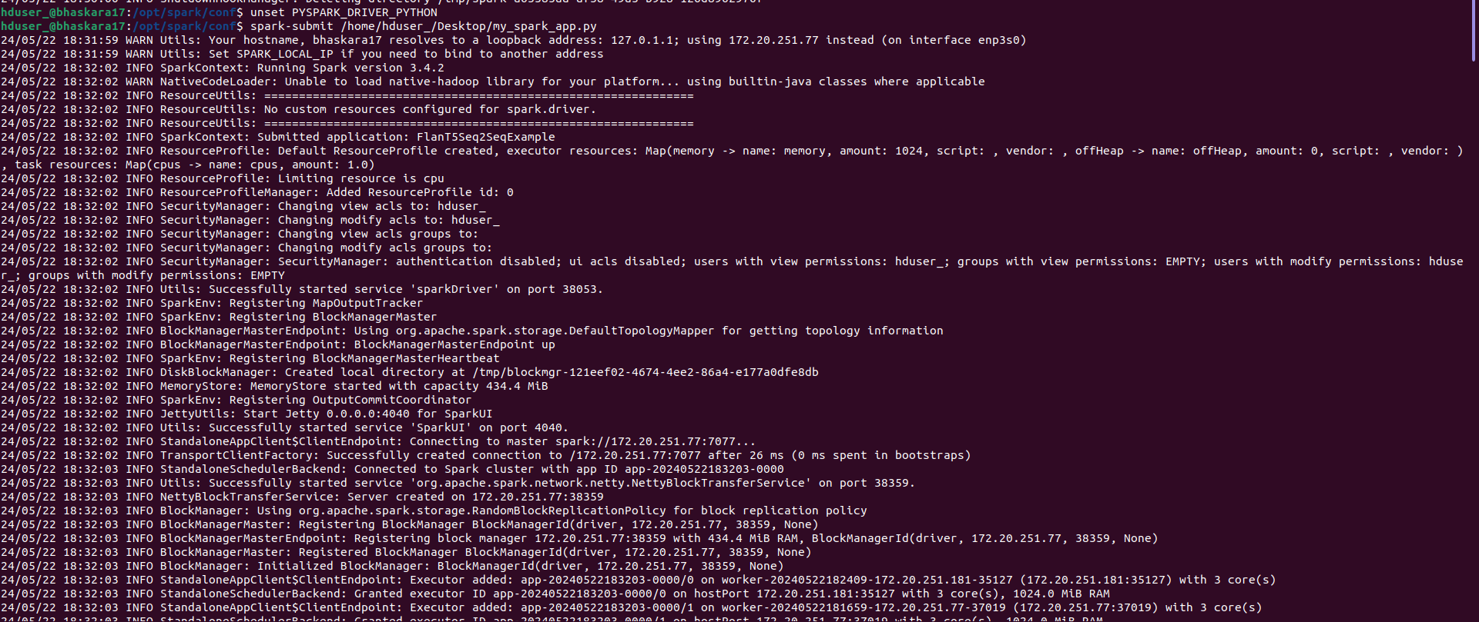
spark-submit <your .py file name>.py (Check the my_spark_app.py: Change the SparkSession Builder master address to your respective master node IP address) (Incase of Error : unset PYSPARK_DRIVER_PYTHON then above code)

Slide 15
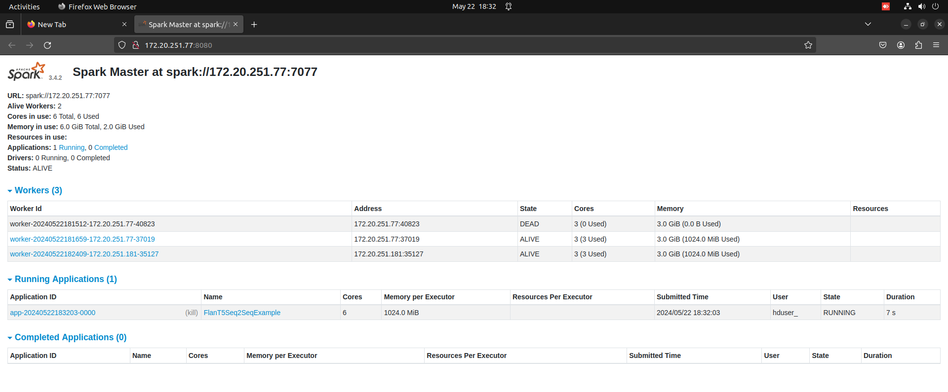
Update Spark UI

Slide 16
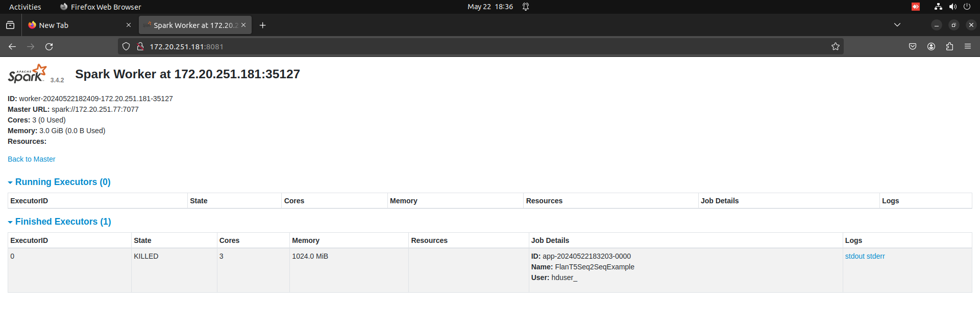


Slide 17
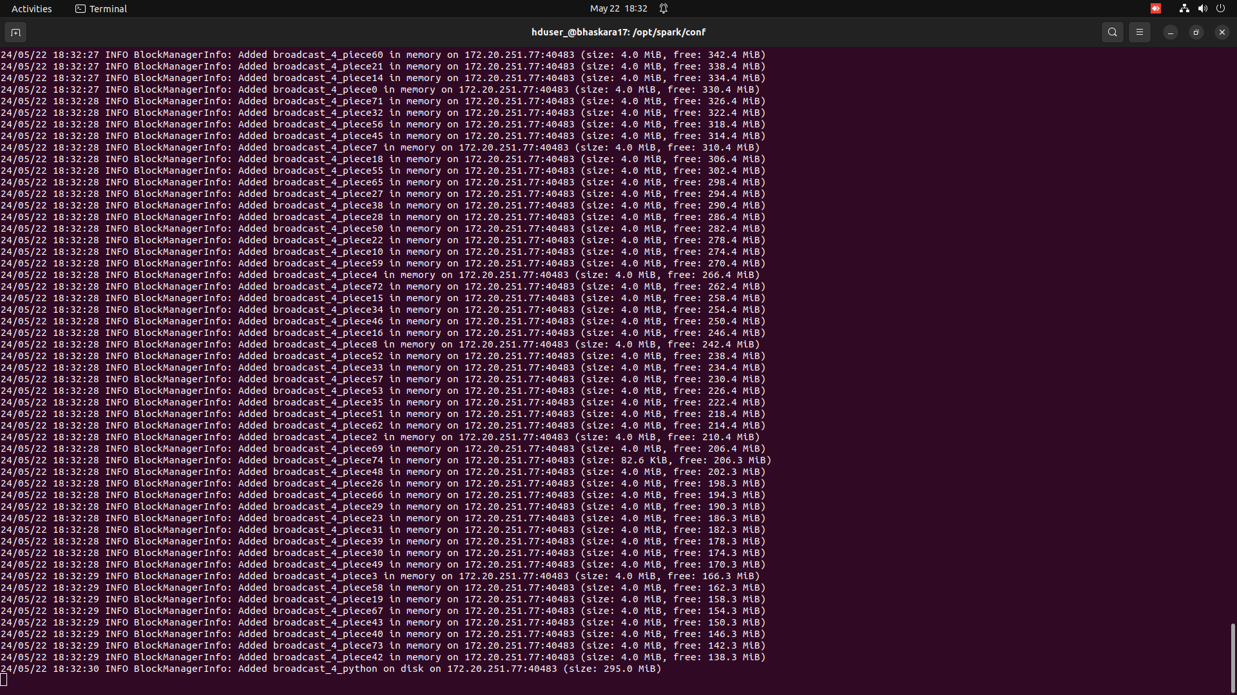
Workings

Slide 18
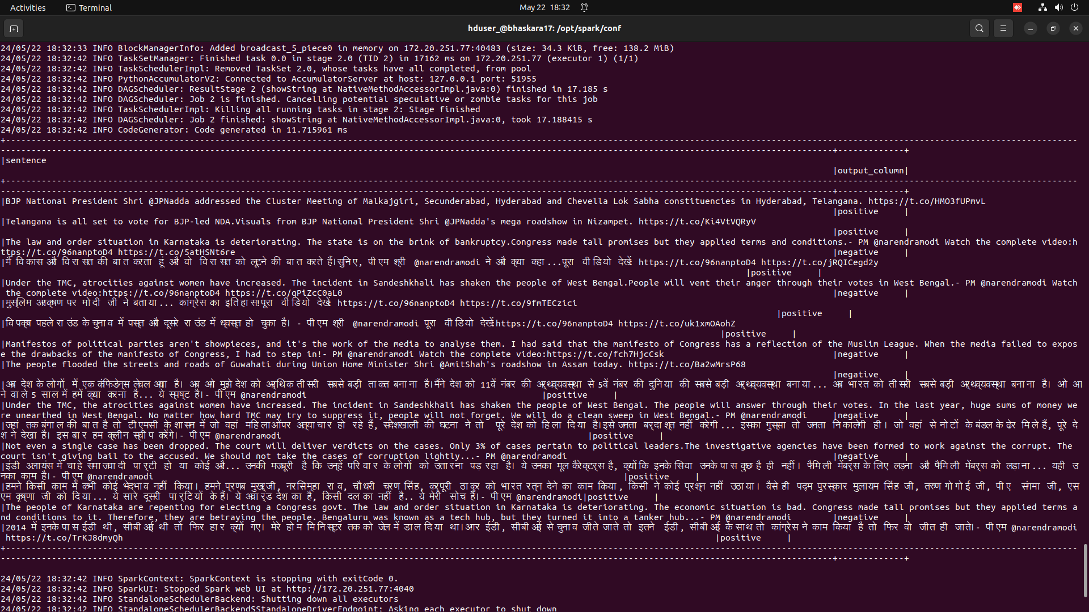
Output

Slide 19
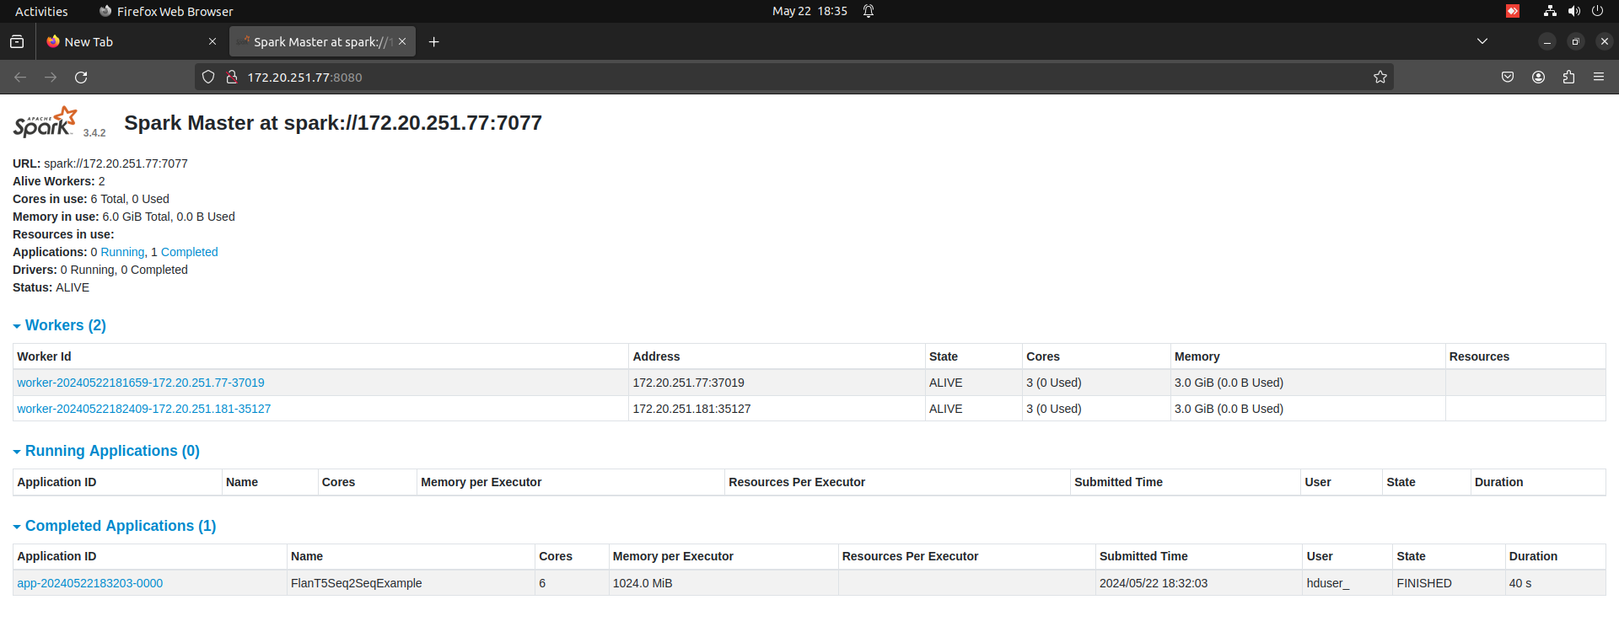
Update Spark UI

Slide 20
To Know more about the Model used
https://huggingface.co/google/flan-t5-small

